Slide 1
CSSE Capstone
Inventory app

Slide 2
Agile
Framework: Scrum.
Sprint Duration: 14 project days (2 weeks).
Ceremonies:
Sprint Planning: Define sprint goals and backlog (2 hours).
Daily Standups: 15-minute sync on progress/blockers.
Sprint Review: Demo features, gather feedback (2 hours).
Sprint Retrospective: Reflect on process improvements (1 hour).

Slide 3
Agile Continued
Artifacts:
Product Backlog: All features/enhancements.
Sprint Backlog: Selected index per sprint.
Increment: Potentially shippable product at sprint end.

Slide 4
Epics
Core Inventory Functionality: CRUD operations, basic UI, API.
Security and Authentication: JWT-based authentication, RBAC.
Advanced Features: Search, offline support, WebSockets, barcode scanning, analytics, internationalization.
Performance and Scalability: Pagination, caching, optimization.
Integrations and Accessibility: IoT integration, accessibility enhancements.
Native Mobile Transition and CI/CD: Swift iOS, Kotlin Android, automated testing/deployment.

Slide 5
Sprint 1 (Day 1–14): Core Backend and Database
Goal: Set up Express.js API and MongoDB schema.
Stories: 1.5 (MongoDB schema, 2 points), 1.1 (Add Item API, 5 points, partial), 1.2 (View Items API, 3 points, partial)
Tasks:
Task 1: Implement Item schema (2 points, 16 hours, Backend)
Define schema with Mongoose (8 hours).
Add text/sparse indexes (4 hours).
Write Jest unit tests (4 hours).
Task 2: Create POST /api/server endpoint (2 points, 16 hours, Backend)
Implement route handler (6 hours).
Add input validation (4 hours).
Write Supertest integration tests (6 hours).

Slide 6
Sprint 1 (Day 1–14): Core Backend and Database Continued
Task 3: Create GET /api/server endpoint (1 point, 8 hours, Backend)
Implement route handler (4 hours).
Write integration tests (4 hours).
Total Points: 5
Total Hours: 40 (Backend: 40, QA: 4 for concurrent test review)
Deliverable: Functional backend API for adding/viewing index.
Assigned Roles: Backend (2), QA (1)

Slide 7
Sprint 2 (Day 15–28): Web Frontend (Vue.js) Core
Goal: Build Vue.js frontend for core CRUD.
Stories: 1.1 (Add Item UI, 5 points, partial), 1.2 (View Items UI, 3 points), 1.3 (Edit Item UI, 5 points, partial), 1.4 (Delete Item UI, 3 points)
Tasks:
Task 1: Create HomePage.vue and ItemList.vue (2 points, 16 hours, Frontend)
Set up Vue Router and HomePage.vue (6 hours).
Implement ItemList.vue with ItemCard.vue using custom PostCSS styles instead of TailwindCSS (6 hours).
Write Vitest unit tests (4 hours).
Task 2: Implement AddItemModal.vue (2 points, 16 hours, Frontend)
Create modal with form using custom PostCSS styles instead of TailwindCSS (6 hours).
Integrate POST /api/server via Axios (6 hours).
Write Cypress E2E tests (4 hours).

Slide 8
Sprint 2 (Day 15–28): Web Frontend (Vue.js) Core Continued
Task 3: Implement EditItemModal.vue (2 points, 16 hours, Frontend)
Create modal with pre-filled form using custom PostCSS styles instead of TailwindCSS (6 hours).
Integrate GET/PUT /api/server/:id (6 hours).
Write E2E tests (4 hours).
Task 4: Add delete functionality (1 point, 8 hours, Frontend)
Add delete button with prompt (4 hours).
Integrate DELETE /api/server/:id (4 hours).
Total Points: 7
Total Hours: 56 (Frontend: 56, QA: 8 for concurrent test review)
Deliverable: Web app with basic CRUD.
Assigned Roles: Frontend (2), QA (1)
Dependencies: Sprint 1 (backend API)

Slide 9
Additional Sprints
Sprint 3 (Day 29–42): React Native Mobile Core
Goal: Build React Native app for core CRUD.
Stories: 1.1, 1.2, 1.3, 1.4 (Mobile UI)
Total Hours: 56 (Swift: 28, Android: 28, QA: 8 for concurrent test review)
Sprint 4 (Day 43–56): Authentication
Goal: Implement JWT-based authentication and RBAC.
Stories: 2.1 (Login, 8 points), 2.2 (RBAC, 5 points)
Total Hours: 64 (Backend: 24, Frontend: 16, Swift: 8, Android: 8, QA: 8 for concurrent test review)

Slide 10
Additional Sprints Continued
Sprint 5 (Day 57–70): Search and Filtering
Goal: Add advanced search and filtering.
Stories: 3.1 (Search/Filter, 5 points)
Total Hours: 44 (Backend: 16, Frontend: 14, Swift: 6, Android: 6, QA: 4 for concurrent test review)
Sprint 6 (Day 71–84): Offline Support
Goal: Enable offline mode with sync.
Stories: 3.2 (Offline Support, 8 points)
Total Hours: 64 (Backend: 24, Frontend: 12, Swift: 14, Android: 14, QA: 8 for concurrent test review)

Slide 11
Additional Sprints Continued
Sprint 7 (Day 85–98): Real-Time Updates
Goal: Add WebSocket-based real-time updates.
Stories: 3.3 (WebSockets, 5 points)
Total Hours: 40 (Backend: 16, Frontend: 12, Swift: 6, Android: 6, QA: 4 for concurrent test review)
Sprint 8 (Day 99–112): Barcode Scanning
Goal: Implement barcode/QR code scanning.
Stories: 3.4 (Barcode Scanning, 5 points)
Total Hours: 40 (Backend: 16, Frontend: 12, Swift: 6, Android: 6, QA: 4 for concurrent test review)

Slide 12
Additional Sprints Continued
Sprint 9 (Day 113–126): Performance Optimization
Goal: Optimize performance with pagination and caching.
Stories: 4.1 (Performance, 5 points)
Total Hours: 40 (Backend: 24, Frontend: 12, QA: 4 for concurrent test review)
Sprint 10 (Day 127–140): Analytics and CI/CD
Goal: Add analytics dashboard and CI/CD pipeline.
Stories: 3.5 (Analytics, 5 points), 6.3 (CI/CD, 5 points)
Total Hours: 64 (Backend: 16, Frontend: 24, DevOps: 24, QA: 8 for concurrent test review)

Slide 13
Additional Sprints Continued
Sprint 11 (Day 141–154): Native Mobile (Swift iOS)
Goal: Prototype native iOS app with SwiftUI.
Stories: 6.1 (Swift iOS, 8 points)
Total Hours: 64 (Swift: 64, QA: 8 for concurrent test review)
Sprint 12 (Day 155–168): Native Mobile (Kotlin Android), Accessibility, IoT
Goal: Prototype native Android app, add accessibility and IoT.
Stories: 5.1 (IoT, 8 points), 5.2 (Accessibility, 5 points), 6.2 (Kotlin Android, 8 points)
Total Hours: 84 (Backend: 12, Frontend: 8, Swift: 6, Android: 58, QA: 8 for concurrent test review)

Slide 14
Additional Sprints Continued
Post-Sprint (Day 169–181): Final Testing and Deployment
Goal: Conduct final testing and deploy the app.
Total Hours: 56 (Frontend: 8, Swift: 10, Android: 10, QA: 12, DevOps: 16)

Slide 15

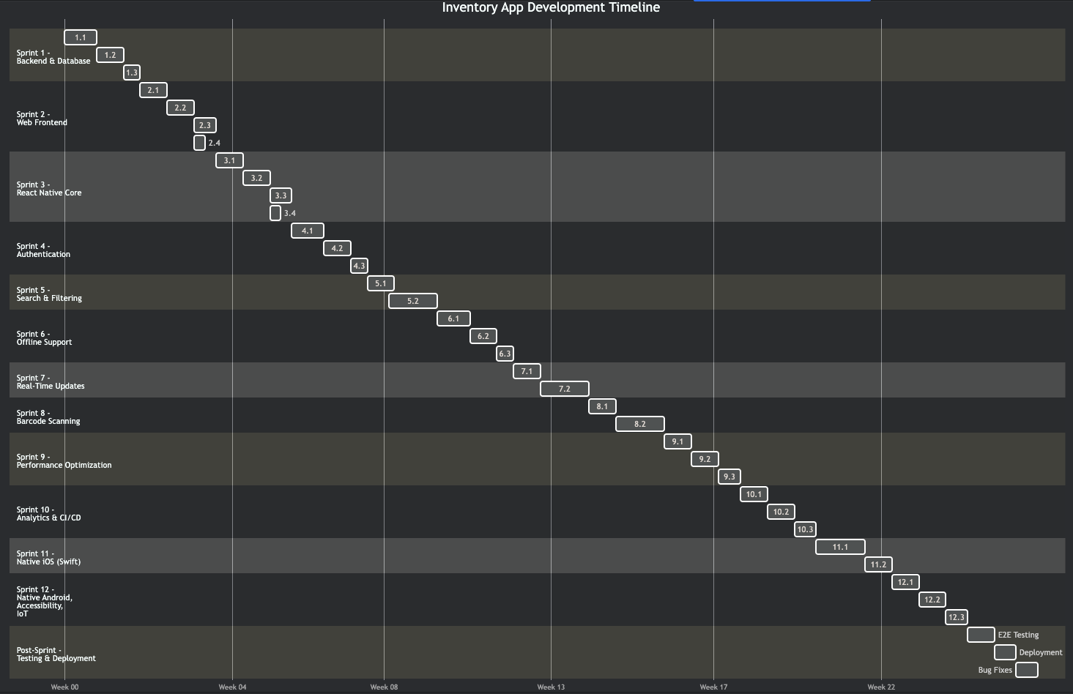



Gantt Chart

Slide 16

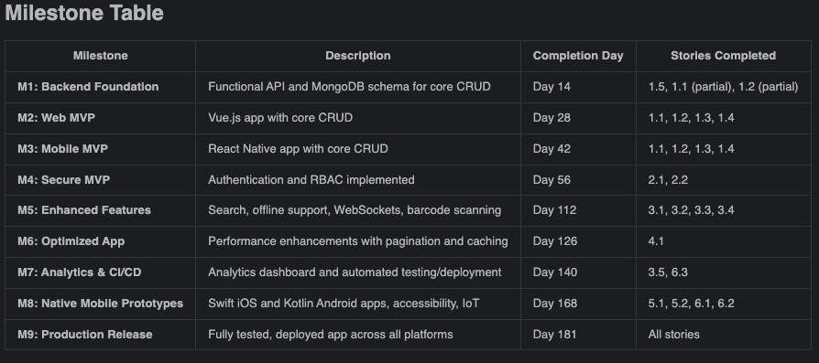

Slide 17
Dependencies and Risks
Dependencies:
Backend API (Sprint 1, Day 1–14) must precede frontend development (Sprints 2–3, Day 15–42).
Authentication (Sprint 4, Day 43–56) is required for RBAC-dependent features (e.g., analytics in Sprint 10, Day 127–140).
CI/CD Pipeline (Sprint 10, Day 127–140) enhances testing for native apps (Sprints 11–12, Day 141–168).
Search and Filtering (Sprint 5, Day 57–70) supports analytics data (Sprint 10, Day 127–140).

Slide 18
Dependencies and Risks Continued
Risks:
Team Skill Gaps: Limited Swift/Kotlin expertise. Mitigation: Cross-train in Sprints 1–4 (Day 1–56).
Integration Complexity: WebSockets/IoT compatibility issues. Mitigation: Prototype in Sprint 7 (Day 85–98) and Sprint 12 (Day 155–168).
Scope Creep: Could-have features (analytics, IoT) may delay core features. Mitigation: Adhere to MoSCoW prioritization.
Performance Bottlenecks: Large inventories may slow app. Mitigation: Prioritize performance in Sprint 9 (Day 113–126).
Styling Complexity (Updated): Team may have limited expertise with custom PostCSS styling after switching from TailwindCSS, potentially increasing styling time for UI tasks in future sprints (e.g., search UI in Sprint 5, accessibility in Sprint 12). Mitigation: Provide training on PostCSS and CSS best practices before Sprint 5 (Day 57–70); allocate additional styling time in Sprint 5 and Sprint 12 tasks.

Slide 19
Metrics and Success Criteria
Velocity
Target 5–8 points per sprint per developer pair, adjusting based on complexity.
Definition of Done
Code reviewed, merged into main.
Tests pass (90% coverage).
Deployed to staging, verified by QA.
Documentation updated.

Slide 20
Metrics and Success Criteria Continued
Success Criteria
Day 42 (Sprint 3): Core CRUD for web and React Native.
Day 84 (Sprint 6): Must-have enhancements (authentication, search, offline).
Day 168 (Sprint 12): Native iOS/Android prototypes, Should-have/Could-have enhancements.
Day 181 (Post-Sprint): Production-ready app, zero critical bugs.

Slide 21
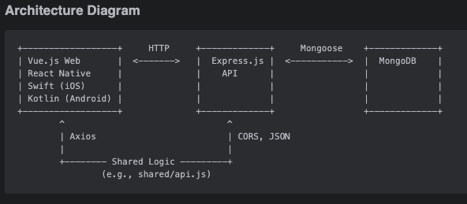

Slide 22
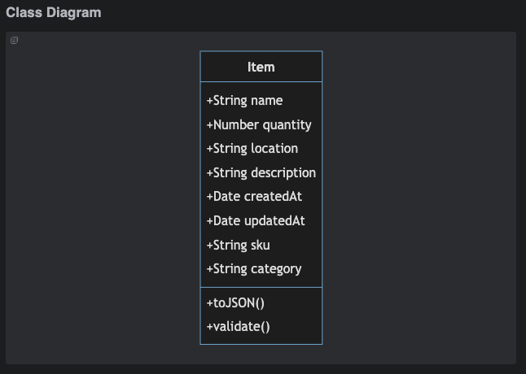

Slide 23
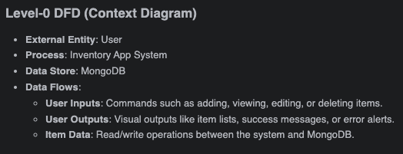
Data Flow Diagram

Slide 24
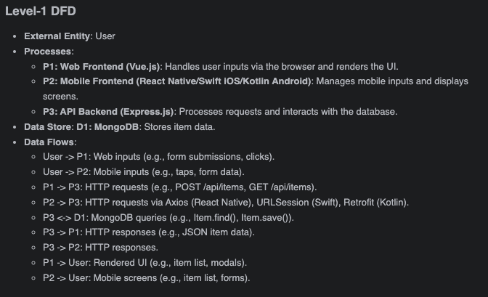
Data Flow Diagram Continued

Slide 25
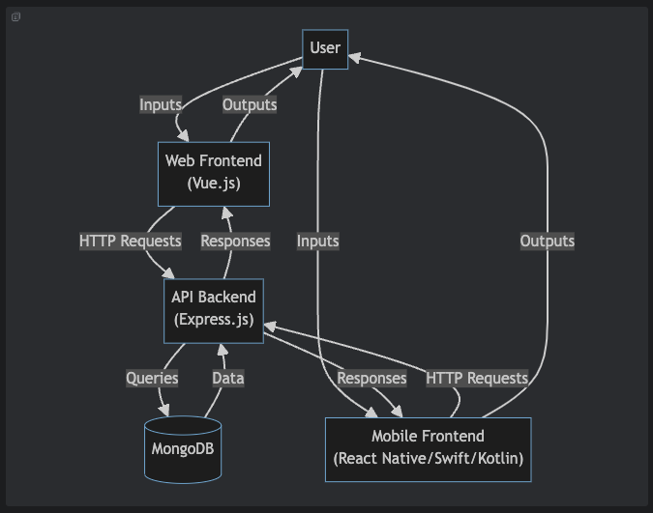
Data Flow Diagram Continued

Slide 26
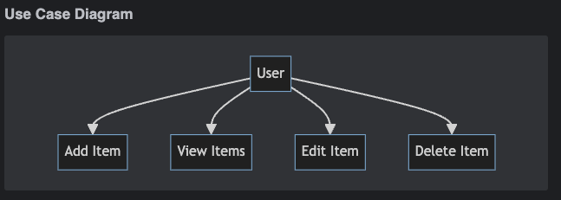
Use Case Diagram

Slide 27
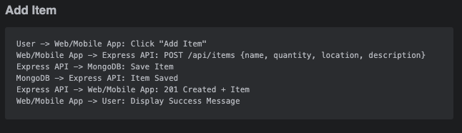
Sequence Diagram

Slide 28
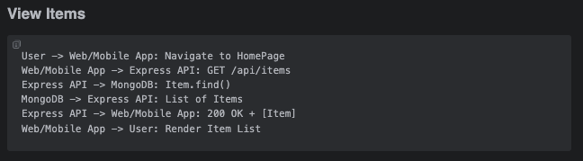
Sequence Diagram Continued

Slide 29
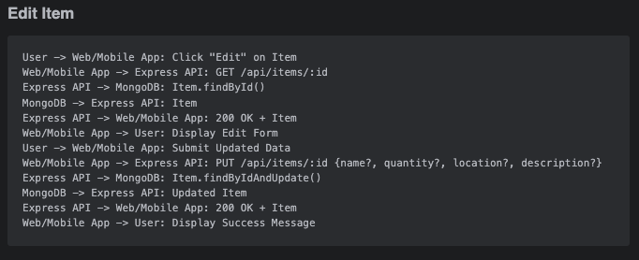
Sequence Diagram Continued

Slide 30
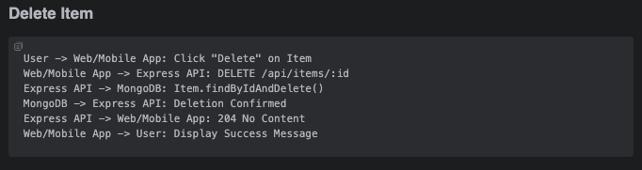
Sequence Diagram Continued

Slide 31
Questions???

